Slide 1
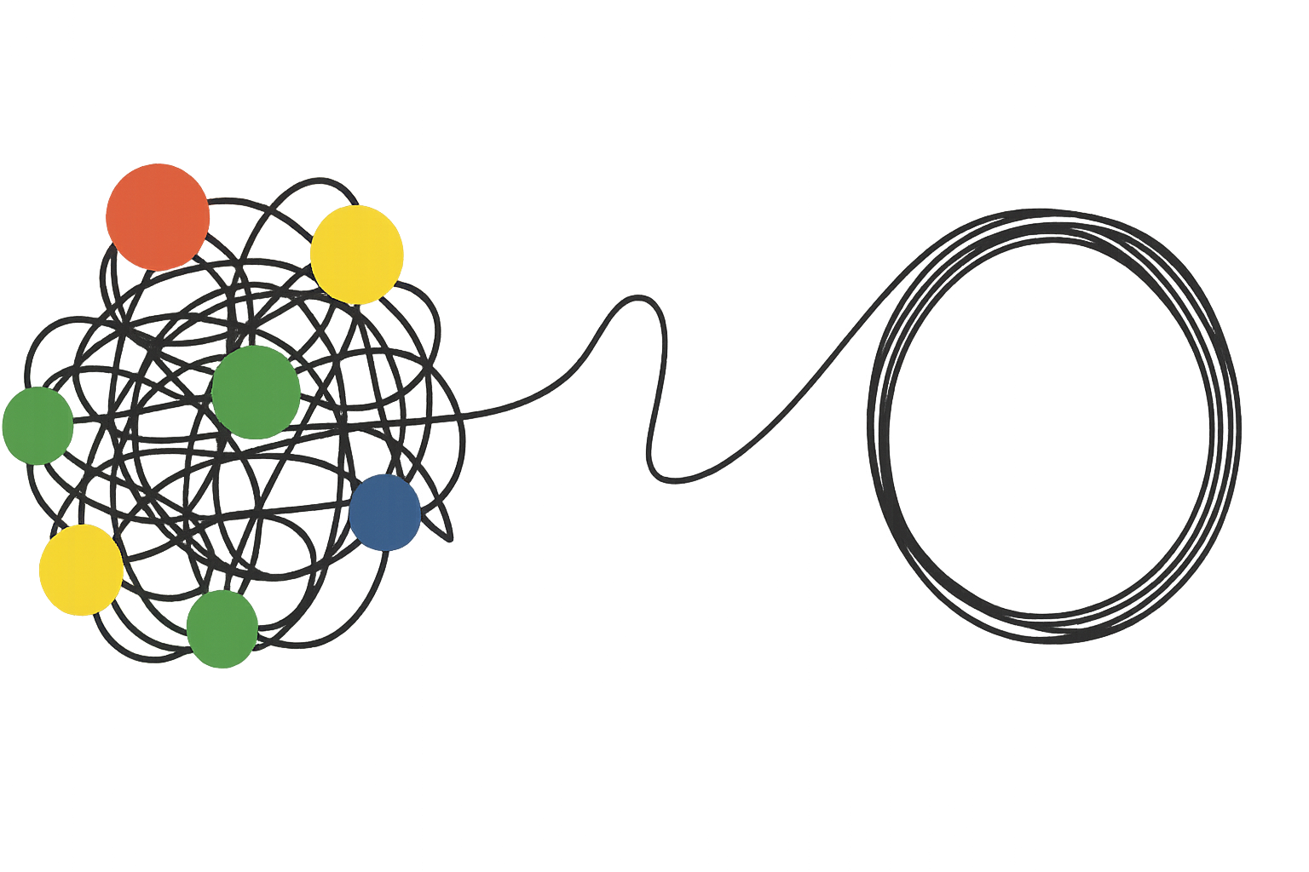
July 17, 2025
Untangling DevRel
Using Network Graphs to Tell a Story
Kourtney Meiss (she/her)
Notes:
Say that i’m going to explain what a network graph is

Slide 2

About Me
Massachusetts > South Carolina > Texas
Developer Advocacy at Box > TraceLink > Amazon
2nd DevRelCon
Avid reader
50+ houseplants
Notes:
Computer science degree
Tenure at box and tracelink

Slide 3
Summary
Background
Existing models
The gap
My model
Network graphs
Uses
Next steps
Notes:
45 seconds
“First, I’ll give you a quick background on how I started working on this idea, and walk through some of the existing models I explored as a foundation. Then I’ll outline the gap I saw in those approaches, which led me to develop my own model. From there, I’ll cover the basics you need to know about network graphs—just enough to understand how they fit in—and then show some of the key ways my model can be used. Finally, I’ll wrap up with the next steps I see for applying and building on this work moving forward.”

Slide 4
Core Question
What would a company need to think about as early as possible to set DevRel up for success later on?
“Begin with the end in mind” - Stephen Covey
Notes:
“When I started at TraceLink, their Platform had just launched and we were building a DevRel program from the ground up.
And in those early days, we started uncovering things that needed to change—from parts of the backend architecture to product features that suddenly needed to even put something in front of developers.
That led me to ask a bigger question: What would a company need to think about as early as possible to set DevRel up for success later on?
I found myself wishing I had a model to answer that question
I was reminded of a quote from Stephen Covey my dad used to always say growing up about problem solving which was: ‘Begin with the end in mind.’
So I did. I started mapping out all the behind-the-scenes dependencies—every internal team DevRel touches, all the invisible layers of effort that need to align for a program to grow and mature.
And the more I mapped, the more I realized: this wasn’t just a planning tool. It was becoming a way to visually explain DevRel’s impact—especially to stakeholders who aren’t in the day-to-day, may’ve never worked with DevRel before and don’t know what they don’t know.

Slide 5
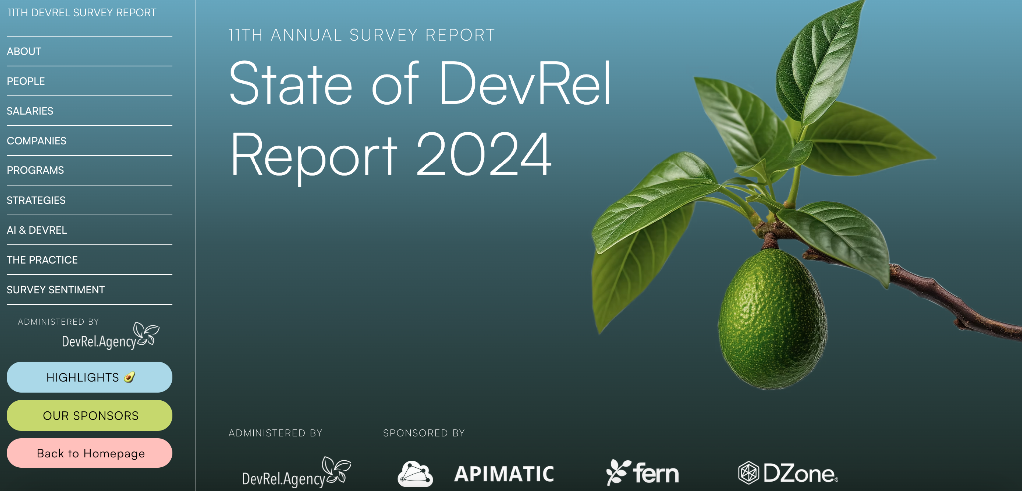
Background
61%
Find it difficult to prove influence
50%
Struggle to raise awareness of contributions
2nd
Challenge: Prove business impact
Source: 2024 State of DevRel Report by DevRel.Agency
Notes:
2 minutes
When the 2024 State of DevRel report came out, and it validated I was thinking:“If you’re not familiar, the DevRel Agency’s annual survey is one of the most widely referenced reports in our field—it captures things like how DevRel teams are structured, what they’re focused on, and the challenges they’re facing across the industry.”
61% of DevRel professionals say it’s hard to prove their influence
50% struggle to raise awareness of what they do
And for the first time, ‘proving business impact’ became one of the top two challenges
That’s when I knew this model could be useful—not just to me, but to others trying to make DevRel more visible, more actionable, and ultimately more valued.”

Slide 6
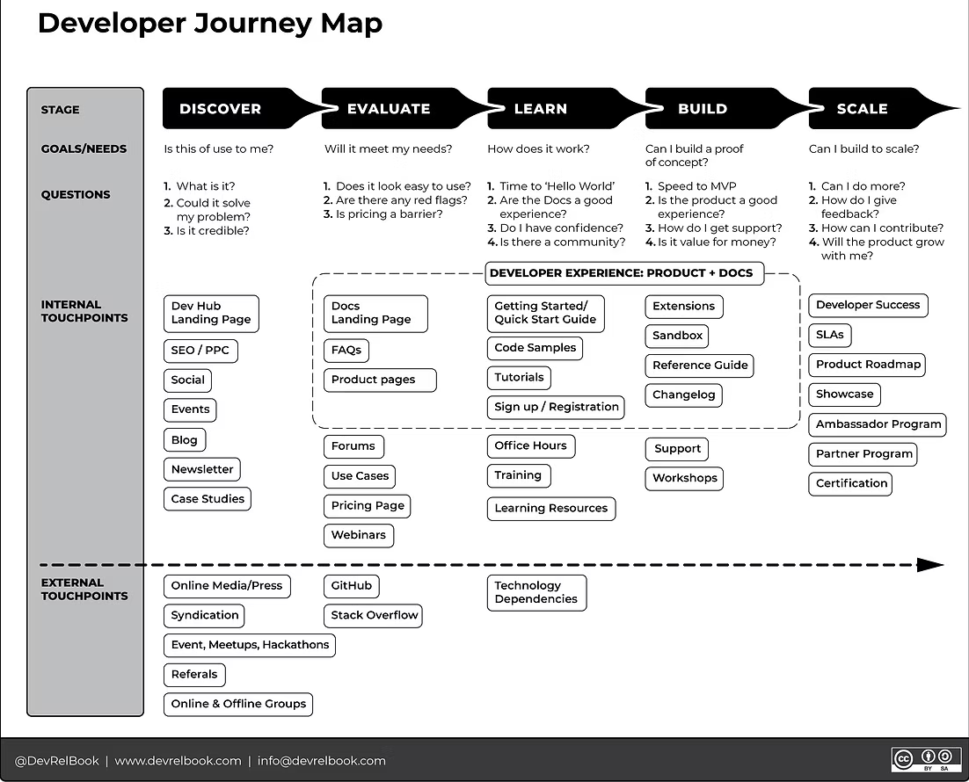
Existing Models
Is there a model that visualizes the internal structure and impact of DevRel programs, especially as they grow and mature over time?
Notes:
1 minute
“Before I poured more into this project and decided what my model should actually look like, I wanted to make sure I wasn’t reinventing the wheel.
So I stepped back and asked: Has someone already done this? Is there already a model out there that visualizes the internal structure and impact of DevRel programs—especially as they grow and mature over time?
What I found was: no—no one had done exactly this before.
But I did find a few models that captured pieces of what I was thinking.
They resonated with me, but they weren’t quite the whole picture.
The first is a well-known model ( Developer Journey Map (link) from DevRel Agency. It maps the stages of the developer journey to specific touchpoints—giving you a clear sense of how to engage developers at each phase.
If your program is just getting started, like ours was at TraceLink, this can be a really useful tool. It helps you prioritize the right touch points early on and adjust your focus as the program matures and you move deeper into the journey.”

Slide 7
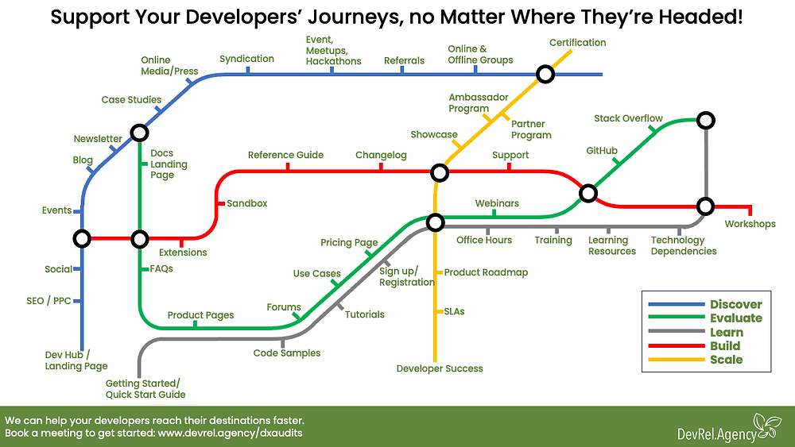
Existing Models
Notes:
30-45 seconds
“The second was the ‘Mind the Gap’ Developer Journey Tube Map, (link) also created by DevRel Agency. It builds on the same stages and touch points as the original journey map, but adds a layer of complexity—showing that the developer experience isn’t linear.
Developers can enter at any point, take different paths, and jump between tracks depending on their goals and needs.
It’s a brilliant visualization of just how non-linear, fragmented, and dynamic the developer journey really is.”

Slide 8
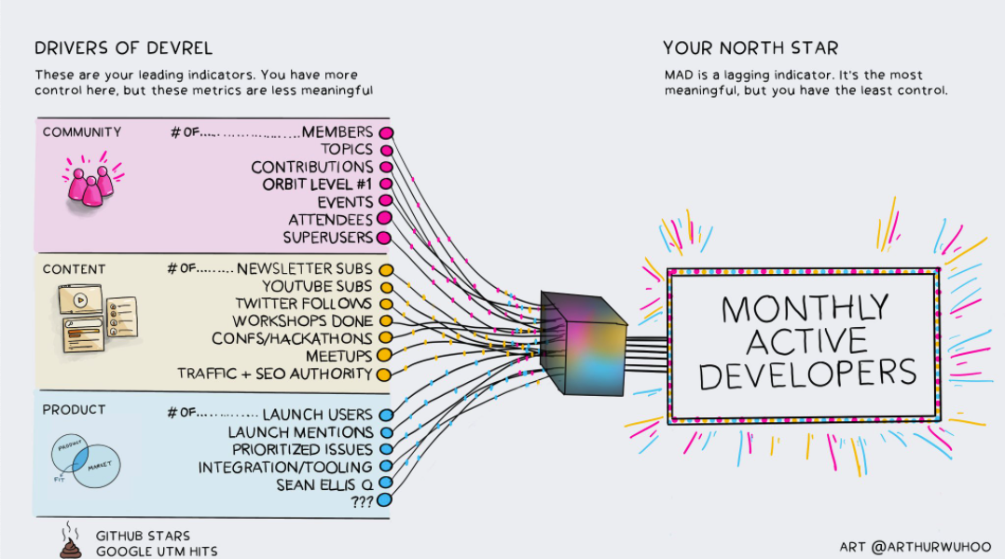
Existing Models
Source: Shawn Wang @swyx
Notes:
The last one I’ll show you is a model by Shawn Wang @swyx illustrating how monthly active developer metric breaks down into individual community, content, and product metrics. He argues that your north star metric should not be monthly active developers because it’s multi-causal and a lagging indicator. Instead, you need more leading indicators you have direct control over, shown on the left.
When I looked at this model I wanted to capture all these efforts that need to go into making these

Slide 9
The Gap
Internal functions
Cross-functional collaboration
Dependencies
Foundational choices
Maturity over time
Team ownership
Non-linear, but interconnected
Notes:
But what I felt like was missing was the internal function of DevRel-- the behind-the-scenes work needed to make all these touchpoints work.
The cross-functional collaboration and dependencies, the foundational choices, the maturity over time, and teams needed to make it happen.
And that all of this is non-linear, but inter-connected
I kept coming back to the question I had during those early days: What would a company need to know and build early on to make DevRel successful later?
This was the basis for my new model.
Something that could map out not just the developer’s journey, but the organizational mechanisms that supports it.
______________________________________
I couldn’t find a framework that communicated the following in one:
“From my experience—and from talking with other DevRel folks—the more connected we are to other parts of the company, the more likely we are to deliver real business impact.
But ironically, that same cross-functionality makes it harder to clearly communicate our value. We’re everywhere—but that means our success isn’t always easy to pin down.
That’s why visualizing those relationships can be so powerful—it makes the invisible connective tissue of DevRel visible to leadership.”
One thing that stuck with me during that time was a feeling I think many DevRel folks share: leadership just didn’t fully understand what we did or the value we brought. DevRel is complex and touches so many parts of the company, but that complexity often gets lost in translation.
I wanted a better way to show them what was really happening behind the scenes—the intricacies of our day-to-day work. More than that, I wanted a tool to visualize not just the current state, but also how our program could mature and grow over time.
That need sparked the idea for this framework: using visual network graphs to map our relationships, impact, and progress in a way that’s clear, compelling, and impossible to ignore.”
🔄 What Your Network Graph Framework Adds
🧠 1. Focus on Systems, Not Just Individuals
Instead of visualizing a single developer’s path, you're mapping how DevRel interacts across the organization: with Product, Support, Marketing, Community, etc.
This is especially important when you're explaining internal value to stakeholders.
🌐 2. Visualizing Relationships & Interdependencies
Your framework highlights how efforts are connected—not just how a developer moves through stages.
It's about DevRel as connective tissue, not just content production or community building.
⏳ 3. Temporal Growth & Maturity
Your model allows tracking program evolution over time: how relationships deepen, how influence spreads, or where silos emerge.
Others are more like snapshots—yours is more like a time-lapse of a growing network.
📊 4. Persuasive Visual for Leadership
Stakeholders might not care about journeys—they care about outcomes and collaboration.
Network graphs are a familiar structure in business, strategy, and even org charts—making them instantly legible to decision-makers.
“While existing frameworks like the Developer Journey Map or the Mind the Gap tube map help us understand the developer’s experience, they don’t show the organizational effort behind that experience.
My framework takes a systems-level view, mapping how DevRel touches and strengthens every part of the org—from Product to Marketing to Community—and how that influence grows over time.
It’s not just a journey. It’s a network. And for stakeholders, it’s a visual proof of how DevRel makes everything stronger.”
❌ But don’t show cross-functional collaboration
❌ Don’t track program evolution or maturity
❌ Don’t help explain DevRel’s internal influence or impact
“In short, they show what the developer experiences—but not what the organization does to make that happen. That’s the gap I set out to close.”

Slide 10

WORM Model
Workstreams
Ownership
Relationships
Maturity
Notes:
I created the WORM model.
It aims to visualize the internal structure and impact of DevRel programs as they grown and mature over time.

Slide 11
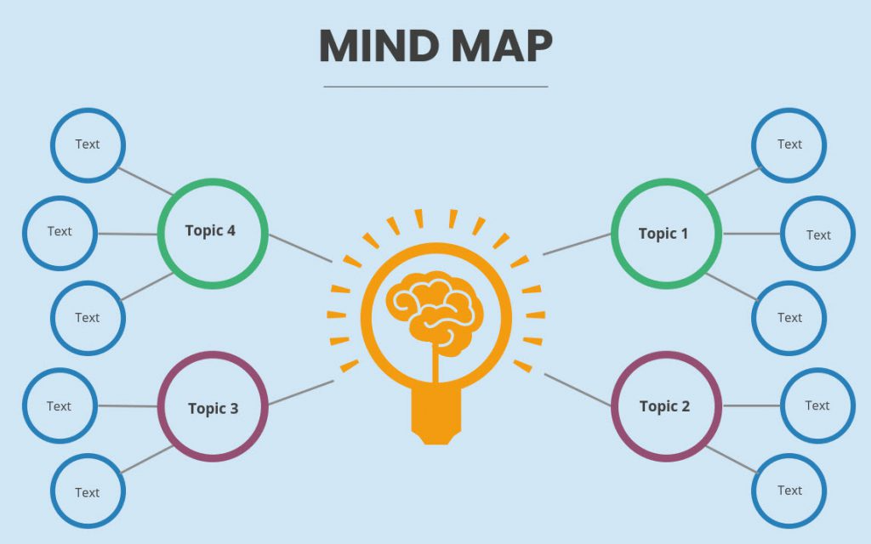
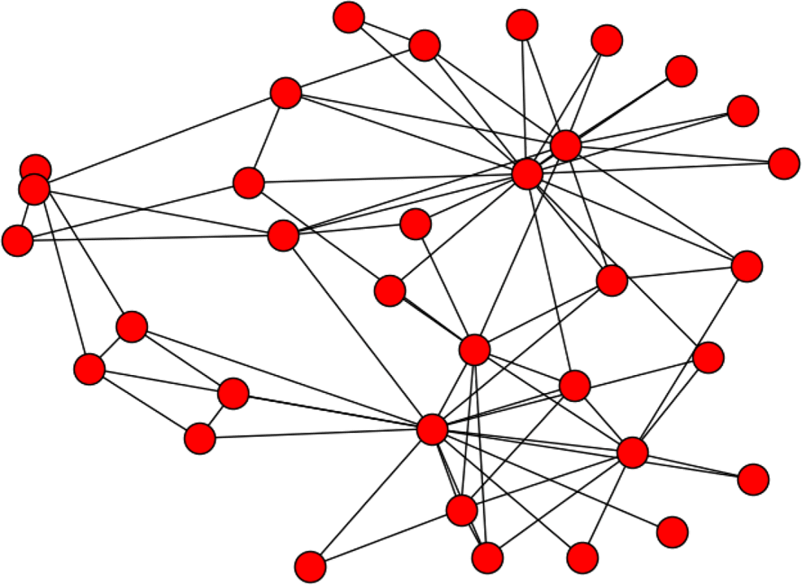
Network Graphs
Network Graph
Notes:
1 minute
“When I started thinking about how to actually draw this thing, my mind went back to elementary school when we used to make mind maps. You’d start with a central idea, then branch out with related thoughts—like outlining an essay or breaking down a topic.
And honestly, that’s what DevRel started to feel like in my head: a central function with tons of branches connecting to other teams, goals, and initiatives.
But I quickly realized that a mind map wasn’t going to cut it. DevRel isn’t just branching outward—it’s a web. The relationships go in every direction.
That’s when I turned to network graphs—a structure designed to show exactly that kind of complexity:

Slide 12
Network Graphs
A
B
C
D
Notes:
There are really only 3 main elements of a network graph you need to be familiar with:
Node - Represents an individual entity
Edges - Connects two nodes representing a relationship or interaction
Direction - CAN BE BI-DIRECTIONAL

Slide 13
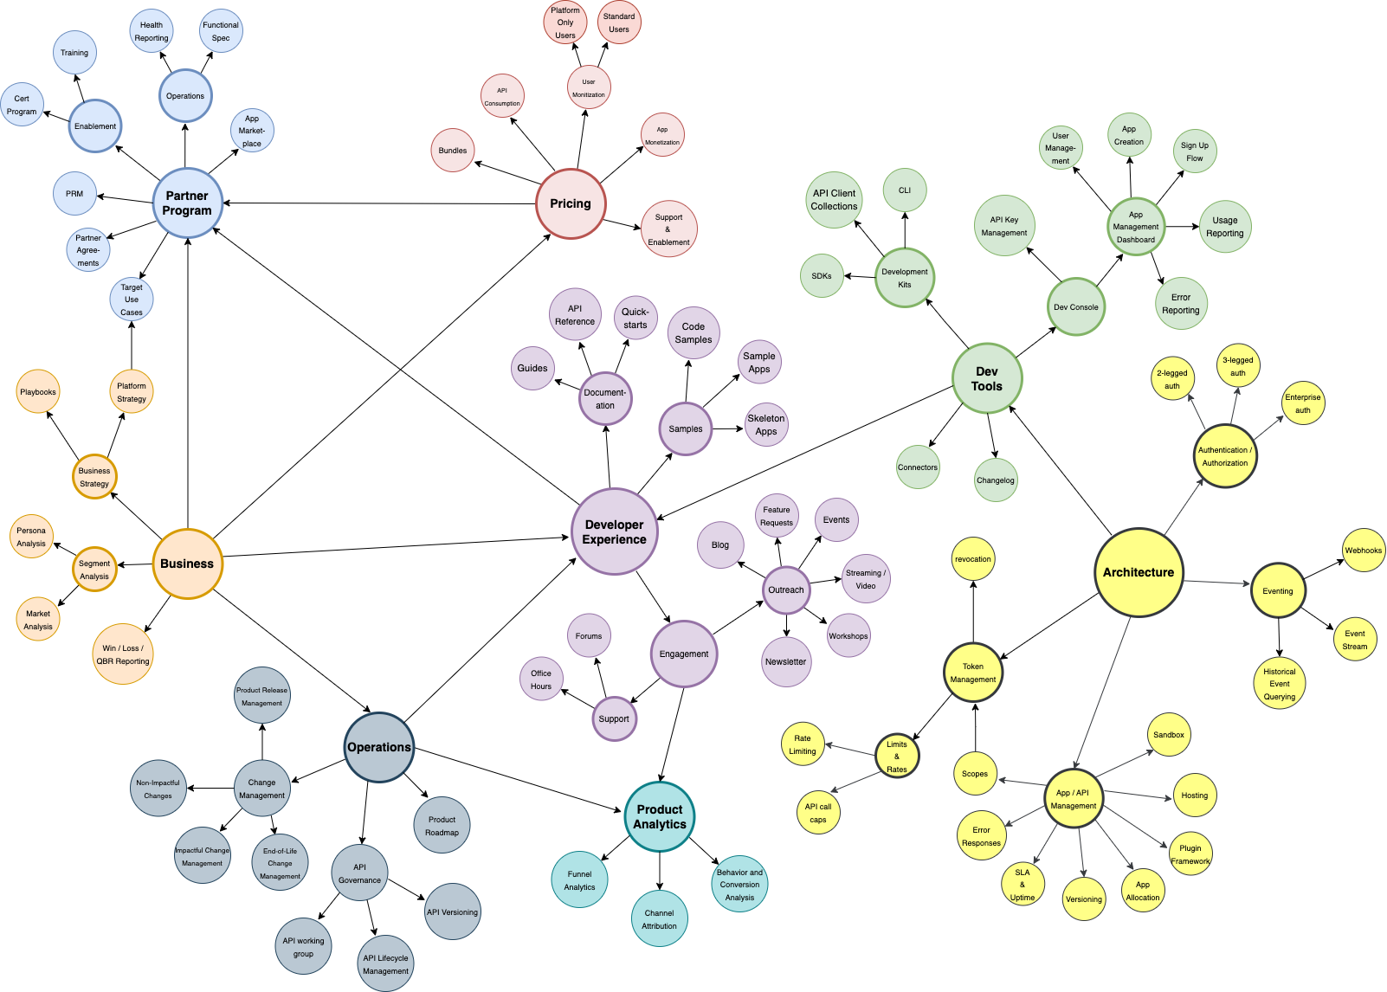

Uses - Segment Overview
Partner Program
Business
Operations
Product Analytics
Dev Experience
Pricing
Dev Tools
Architecture
Notes:
DISCLAIMER: What I’m about to show you is a snapshot of the WORM model I built for TraceLink.
This isn’t a one-size-fits-all model -- The goal isn’t to copy it exactly, but give you a starting point you can edit and adapt to reflect your own org, your own maturity, and your own challenges.
I will give you details on how to access these templates at the end, as it will be hard to read everything from where you’re sitting. I will call out the most important items to focus on.
CLICK
“So here it is. This is the first variation of the model I created— a snapshot of all the areas that DevRel needed to be involved in to build a mature program at TraceLink.
What you’re looking at isn’t just a map of activities—it’s a map of collaboration, dependencies, and ownership that make up the internal side of DevRel.
Our involvement spanned everything from business conversations—like strategy alignment, target personas, and partner programs— to deep technical decisions, like what authentication methods we wanted to support or how to handle api versioning.
Each of the main clusters is color-coded to help you parse it visually: You’ll see the main ones are business, operations, product analytics, architecture, developer experience, dev tools, pricing and the partner program.
The key thing here is: DevRel doesn’t sit in just one of these buckets. It touches all of them.

Slide 14
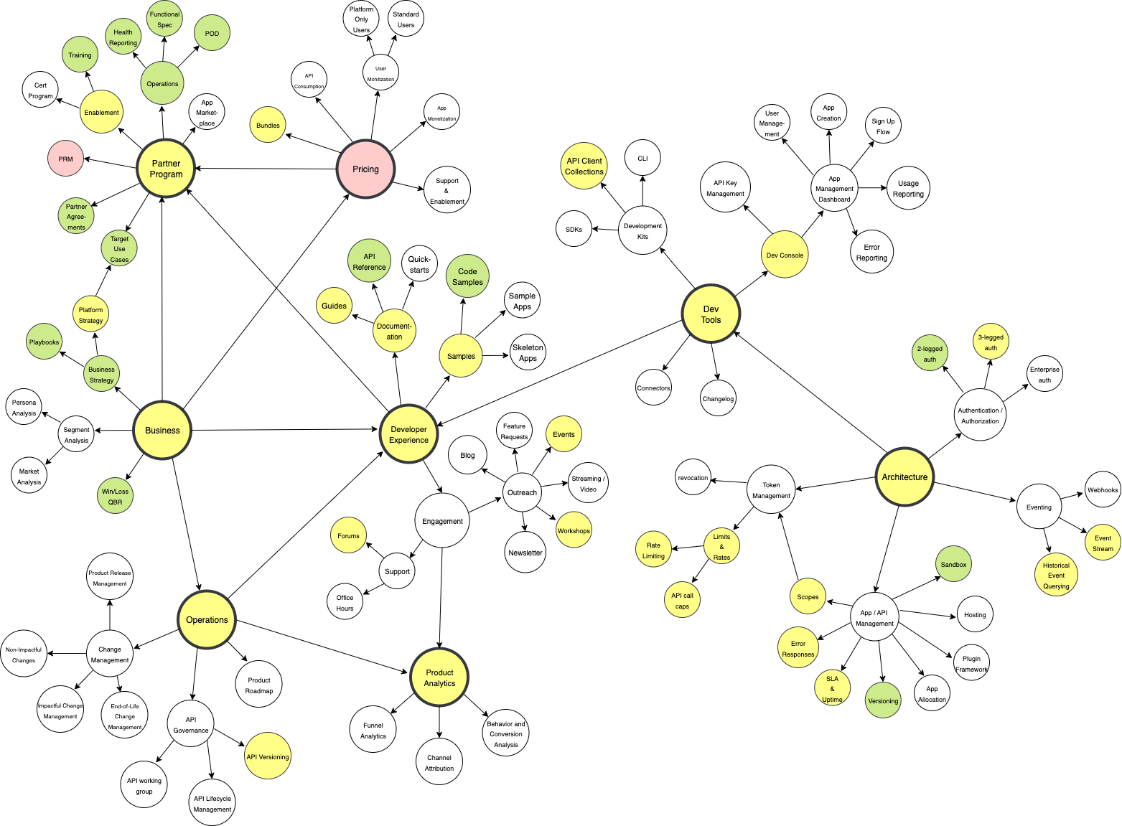

Uses - Health/Status
In Progress
Released/Stable
Blocked/
Needs Attention
Notes:
“This next variation builds on the same structure, but introduces a new layer: health and status.
As we continued building the program, leadership didn’t just want to know what DevRel was involved with —but how each area was doing.
So this version takes a fully mature program and color-codes each element based on its current health and status.
I used the tool draw.io to create the model, which allowed me to easily go in and change the color of each node.
For example, some areas were in great shape—released, stable, and just in maintenance mode (GREEN)
A work in progress (YELLOW)
Anything blocked and needed attention (RED)
(WHITE) not started
One important internal conversation if you’re using this version would be about what criteria a node must meet in order to move from one status to another.
This helped us have more focused conversations internally with stakeholders. What I love about this version is that you can take one quick glance and immediately understand a much bigger story
It turned the model from a snapshot into a living, strategic tool.”

Slide 15
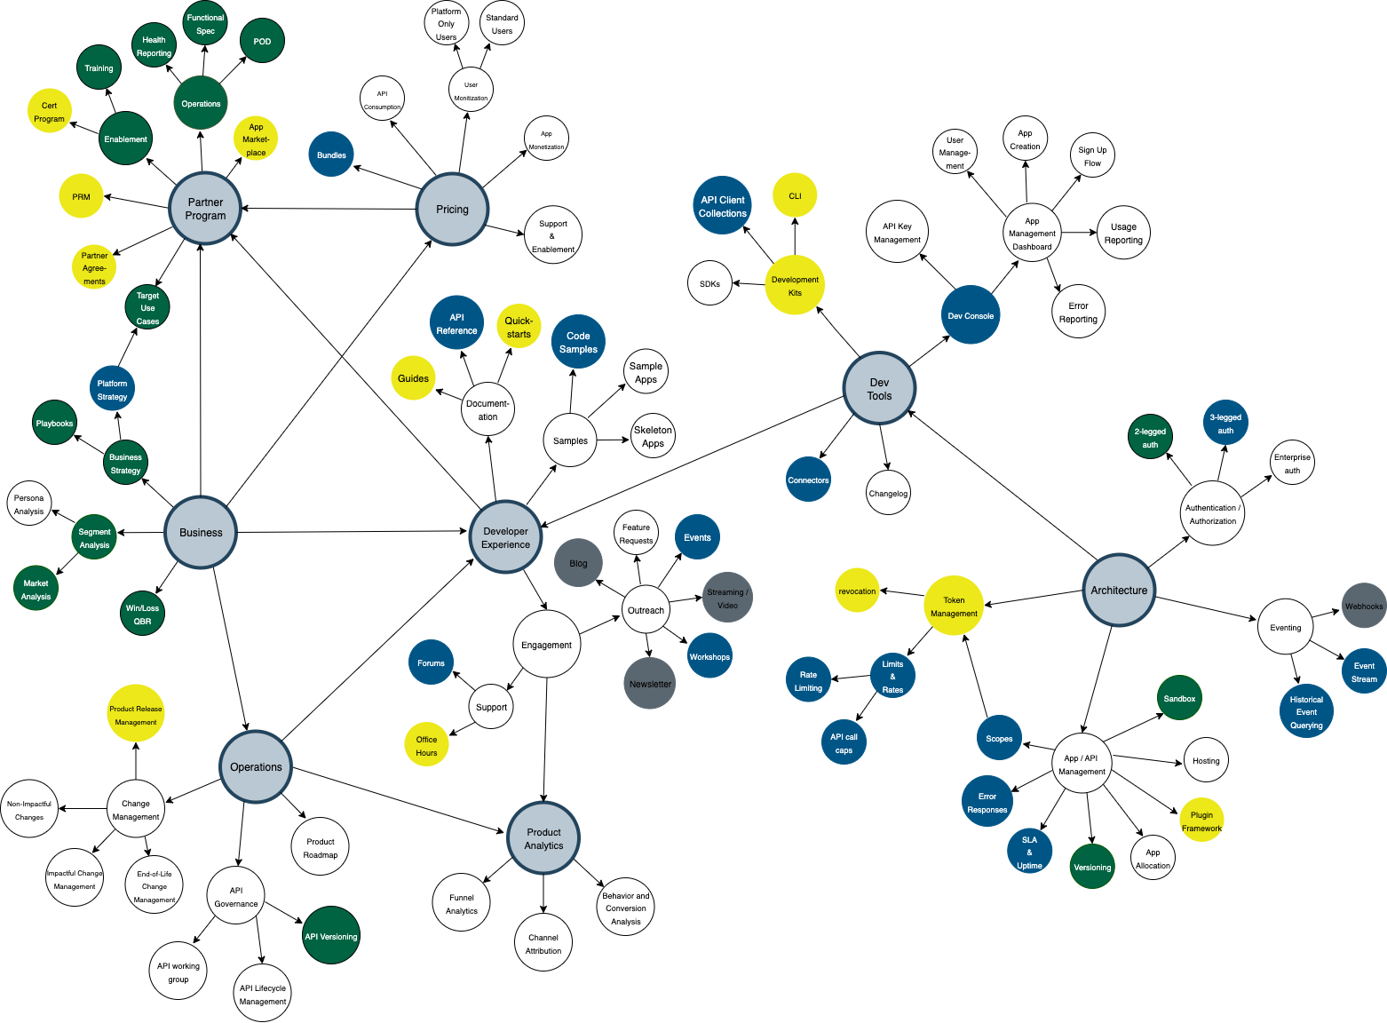

Uses - Planning & Maturity
This Quarter
Completed
2025 Target
Not targeting
Notes:
In this last variation, the color coding shifts again to represent what we were working on that quarter (BLUE), what was on the roadmap for that year (YELLOW) and what we discussed and decided not to target in our program, but could revisit at any time (GREY) it's an important forcing function to ensure you have uncomfortable conversations to make tough decisions to purposefully include / exclude items.
And just like the previous variation, this view gives you a high-level read at a glance. It lets leadership quickly see not just what we’re doing—but how we’re staging that work over time.
This version of the framework became our north star for DevRel planning.
** WHYWHITE
** BIG ONES NEED A STATIC COLOR CAUSE NOOT TECHNICALLY WHITE

Slide 16

GitHub
Notes:
“If any of this resonated with you—or you want to explore it further—I’ve made the full presentation and all the model templates available on GitHub. You can download my templates and use them as a starting place to map your own organization.
And if you do use the model—or even just sit with it for a bit—I’d really love your feedback. What made sense, what didn’t, what you’d add or change.
I truly believe this kind of work gets better when it’s shared and tested in the real world. This isn’t a final answer—it’s a living tool, and I’d love to see how others evolve it for their own orgs.

Slide 17
Acknowledgements & Next Steps
Thank you Jonathan LeBlanc & Chris Traganos
Deep dive on each cluster
Showcase different types of programs
Let’s connect on LinkedIn (Kourtney Meiss)
Notes:
Thank you Jonathan for your support, mentorship, and feedback.
I want to continue to iterate on this framework by creating content deep diving into each cluster.
I’ve also never worked in a marketing-centric program, so I’m hoping to grow this out to show the different flavors of DevRel
And if you’re in the early stages of building DevRel at your company and just need a gut check or sounding board—feel free to reach out. I’m always happy to connect.”

